Slide 1
Big Data Processing
Jiaul Paik
Lecture 16

Slide 2
Graph (Network) Data Processing

Slide 3
Agenda
Basics of Graph Structure
Motivation
Algorithms
Graph Partitioning for community discovery
Counting Triangles in Graph

Slide 4
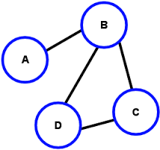
Graph Basics
A graph is composed of two things
Set of objects (called nodes of the graph)
Set of connections (called edges of the graph)
node
edge
Degree of a node = # adjacent nodes
Example: Degree(B) = 3

Slide 5
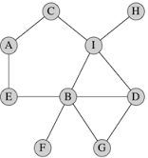
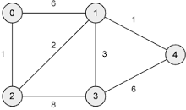
Types of Graph
Un-weighted
Edges do not have weight
Edges simply say whether two objects
are connected or not.
Weighted
Edges have weight
Examples:
Email communication network
How often two persons exchanging emails?
City and Road network
Edge weight: the distance between two cities

Slide 6
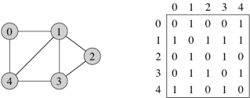
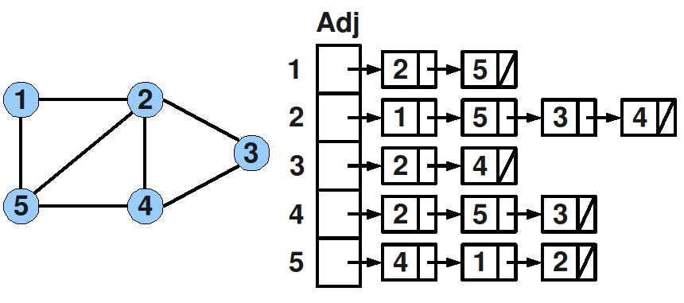
Representing Graph
Adjacency matrix:
Adjacency list:

Slide 7
Why Study Graphs?
Many real-life data and problems are modelled as graph structure
Facebook friendship network
Communities in question-answering website like Quora
And so on..

Slide 8
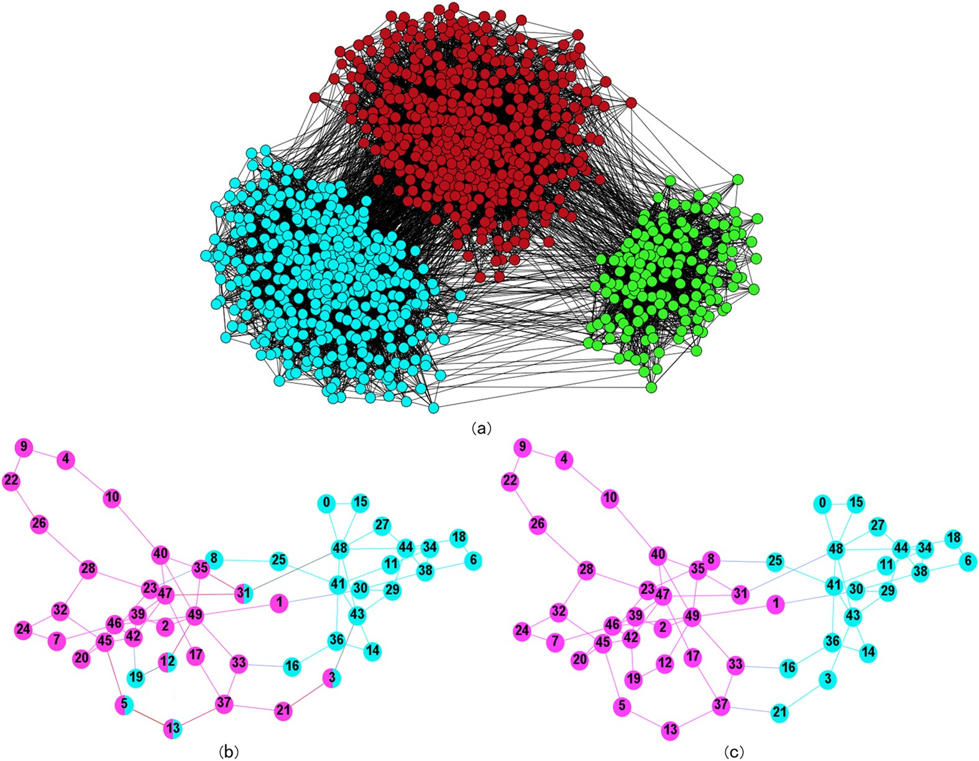
Graph and Communities

Slide 9
Graph Partitioning for Community Discovery

Slide 10
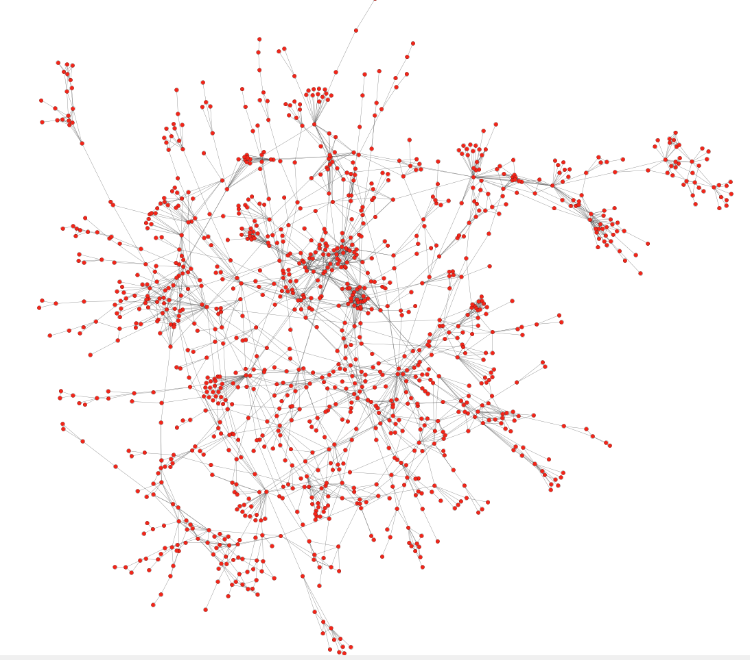
Protein-Protein interaction networks
Can we identify functional modules?
Nodes: Proteins
Edges: Physical interactions
Source: Jure Leskovec, Stanford

Slide 11
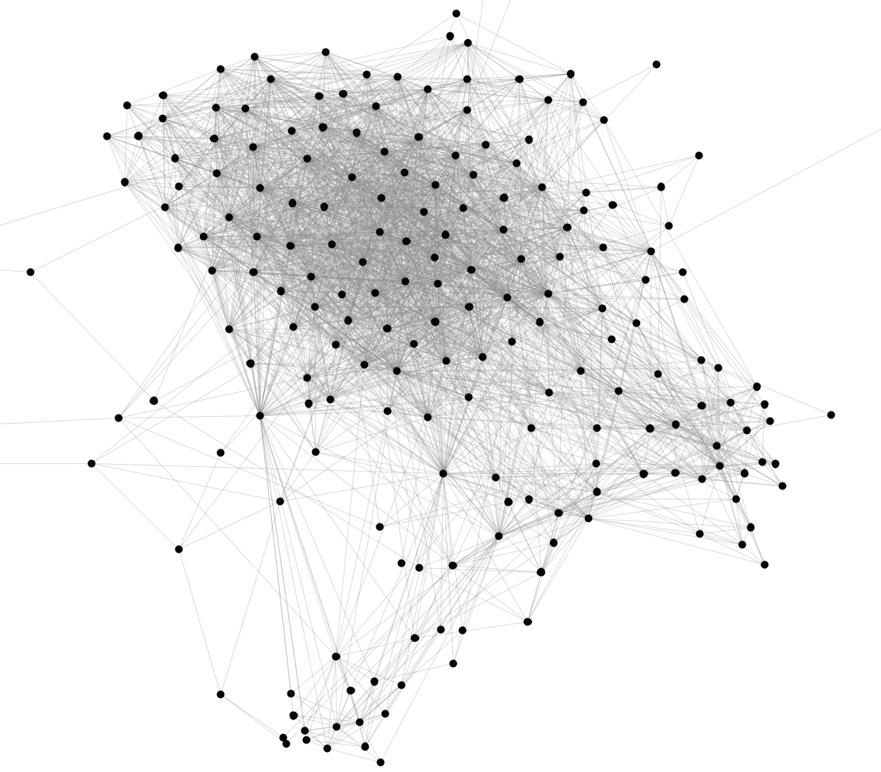
Facebook Network
Can we identify social communities?
Nodes: Facebook Users
Edges: Friendships
Source: Jure Leskovec, Stanford

Slide 12
Communities
Real-life graphs are not random
In social network people pick their friends based on their common interests and activities
Nodes in a graph are typically organized in communities
Groups of nodes which probably share common properties

Slide 13
Community detection as clustering
Community detection is just clustering on graphs.
We can apply clustering algorithms on the adjacency matrix
(e.g., k-means)
We can define a distance or similarity measure between nodes in the graph and apply other algorithms (e.g., hierarchical clustering)
Graphs require specific algorithms

Slide 14
How do we find communities?
Main Characteristics of a community
Within-community nodes are densely connected
Between-community nodes are sparsely connected

Slide 15
The Girvan-Newman Algorithm
Reference: Networks, Crowds, and Markets: Reasoning about a Highly Connected World, Easley and Kleinberg

Slide 16
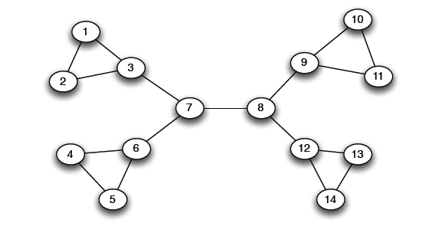
A Motivating Example
Which edge to remove?
“bridge”

Slide 17
The Girvan-Newman method
Hierarchical divisive method
Start with the whole graph
Find edges whose removal “partitions” the graph
Repeat with each subgraph until single vertices

Slide 18
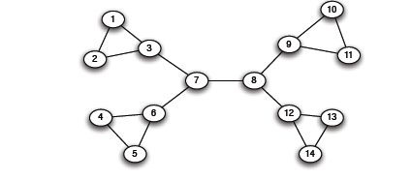
The Girvan-Newman method
Select bridge edges that when removed disconnect the graph
There may be many of those

Slide 19
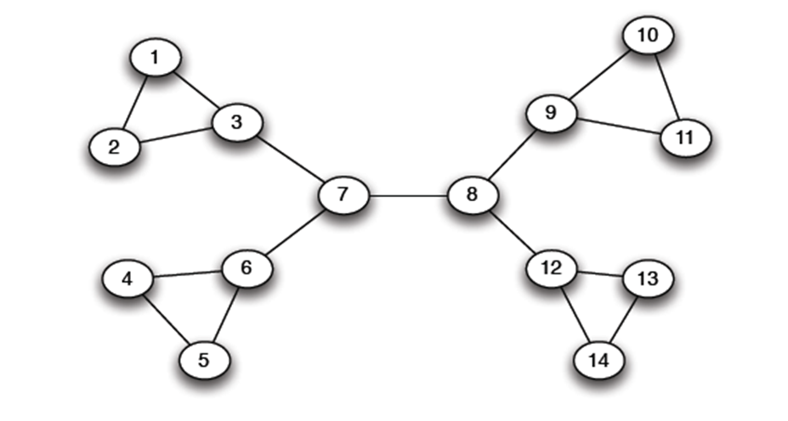
Edge importance
We need a measure of how important an edge is in keeping the graph connected
Edge betweenness: Number of shortest paths that pass through the edge

Slide 20
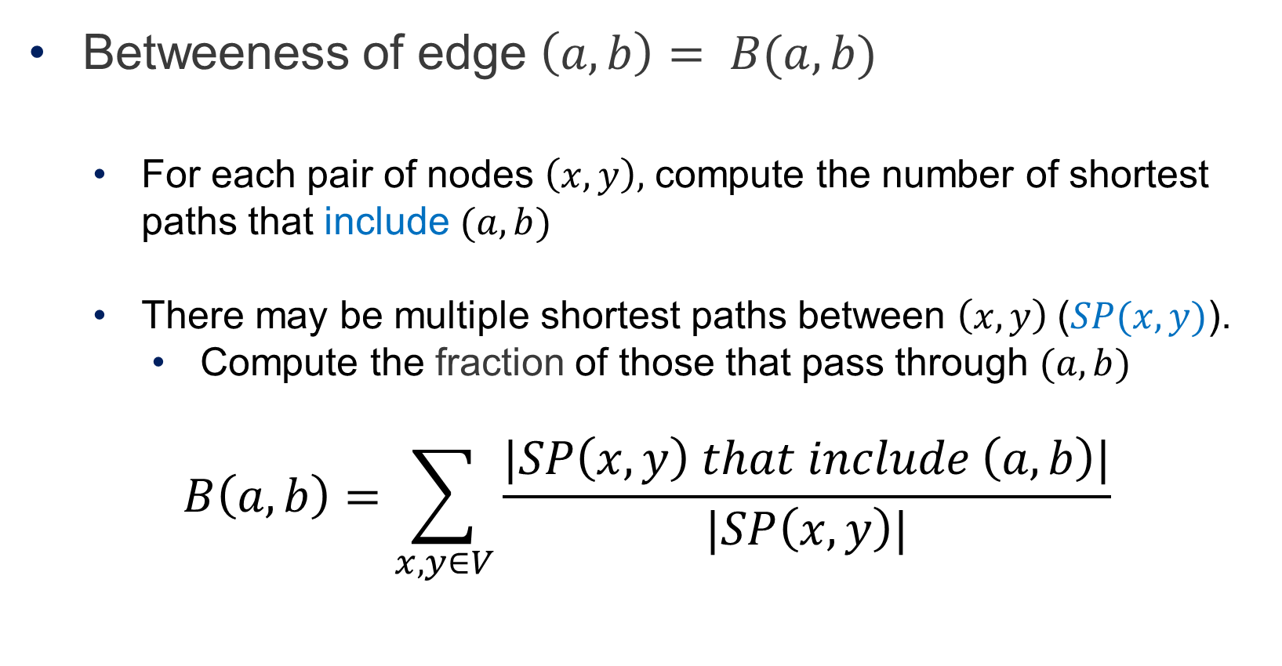
Edge Betweeness
Betweeness of edge $\left(a,b\right)= B(a,b)$
For each pair of nodes $\left(x,y\right),$ compute the number of shortest paths that include $(a,b)$
There may be multiple shortest paths between $\left(x,y\right) \text{(}SP(x,y)\text{)}$.
Compute the fraction of those that pass through $(a,b)$
$$B\left(a,b\right)=\sum_{x,y∈V}{\frac{|SP\left(x,y\right) that include \left(a,b\right)|}{|SP\left(x,y\right)|}}$$

Slide 21
Examples
3x11 = 33
1x12 = 12
7x7 = 49
1

Slide 22
The Girvan-Newman Algorithm
Given an undirected unweighted graph:
Repeat until no edges are left:
Compute the edge betweeness for all edges
Remove the edge with the highest betweeness
At each step of the algorithm, the connected components are the communities

Slide 23
Girvan Newman method: An example
Betweenness(7, 8) = 7x7 = 49
Betweenness(1, 3) = 1X12=12
Betweenness(3, 7) = Betweenness(6, 7) =
Betweenness(8, 9) = Betweenness(8, 12)= 3X11=33

Slide 24
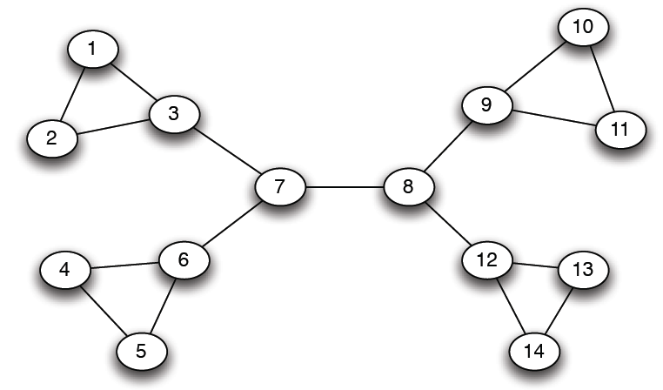
Girvan-Newman: Example
12
1
33
49
Need to re-compute betweenness at every step

Slide 25
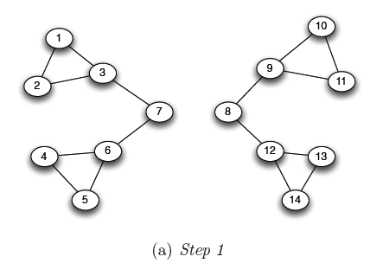
Girvan Newman method: An example
Betweenness(1, 3) = 1X5=5
Betweenness(3,7) = Betweenness(6,7) = Betweenness(8,9) = Betweenness(8,12) = 3X4=12

Slide 26
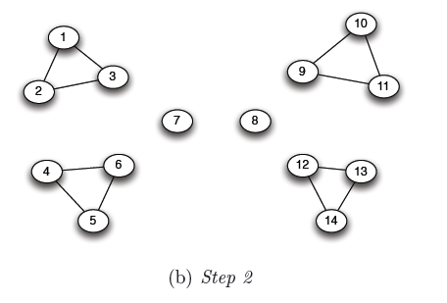
Girvan Newman method: An example
Betweenness of every edge = 1

Slide 27
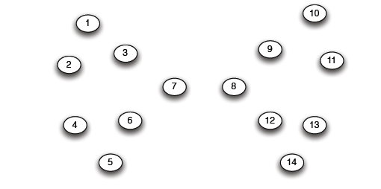
Girvan Newman method: An example

Slide 28
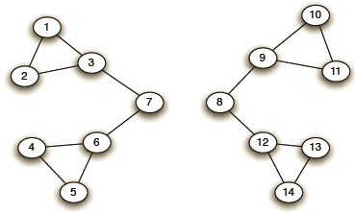
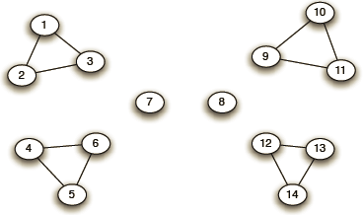
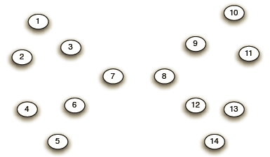
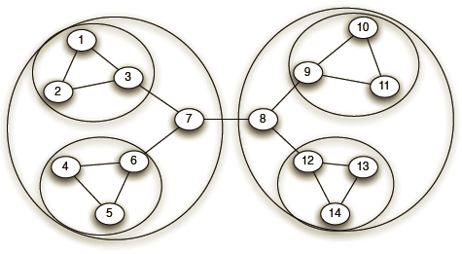
Girvan-Newman: Example
Step 1:
Step 2:
Step 3:
Hierarchical network decomposition:

Slide 29
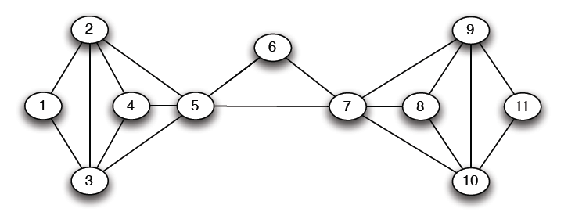
Another example
5X5=25

Slide 30
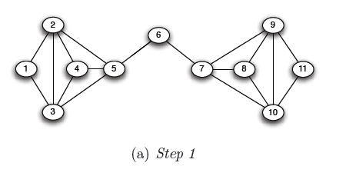
Another example
5X6=30
5X6=30

Slide 31
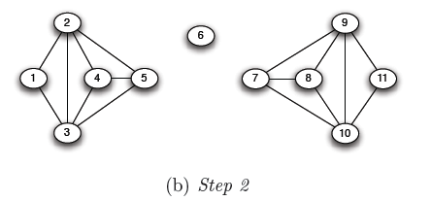
Another example

Slide 32
Computing Betweenness
Perform a Breadth-First-Search (BFS) starting from A
Determine the number of shortest path from A to each other node
Based on these numbers, determine the amount of flow from A to all other nodes that uses each edge

Slide 33
Counting Triangles

Slide 34
Problem Definition
Given an unweighted-undirected graph, find the number of three-node sets such that all three nodes are connected
Example:
2
1
3
4
Triangle: {2,3,4}

Slide 35
Why triangles are important?

Slide 36
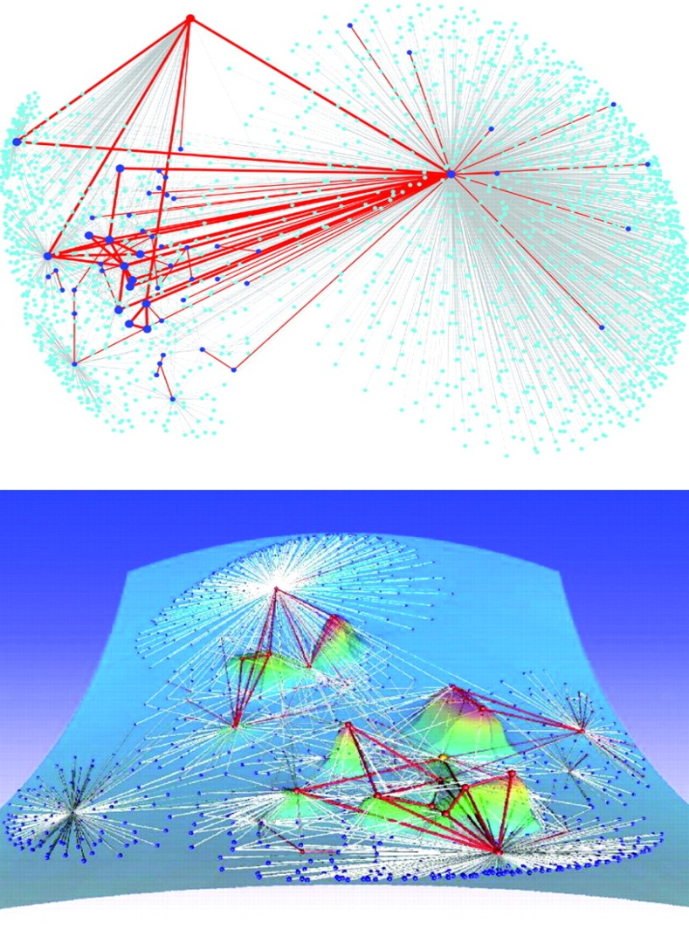
Example 1
Regions dense in triangles indicate a common topic!
Eckmann-Moses, Uncovering the Hidden Thematic Structure of the Web (PNAS, 2001)

Slide 37
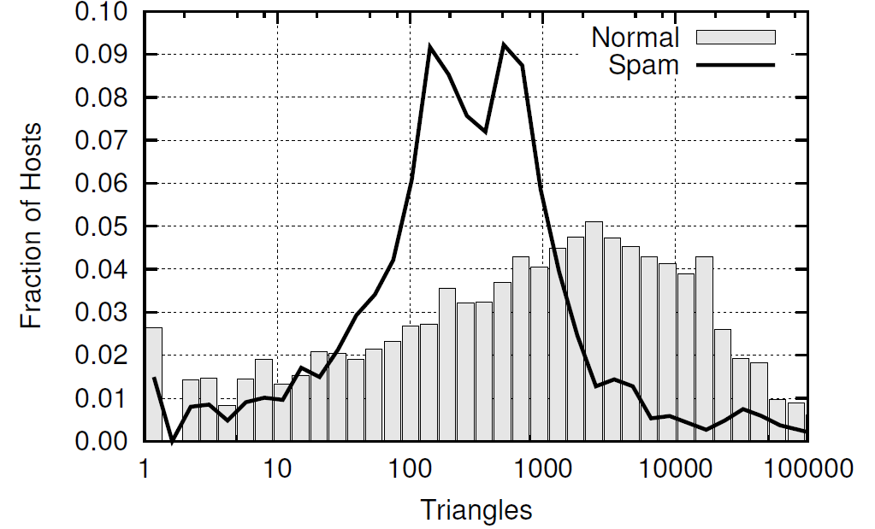
Example 2
Triangle Distribution among spam hosts is significantly different
from non-spam hosts!
Becchetti et al. KDD ‘08

Slide 38
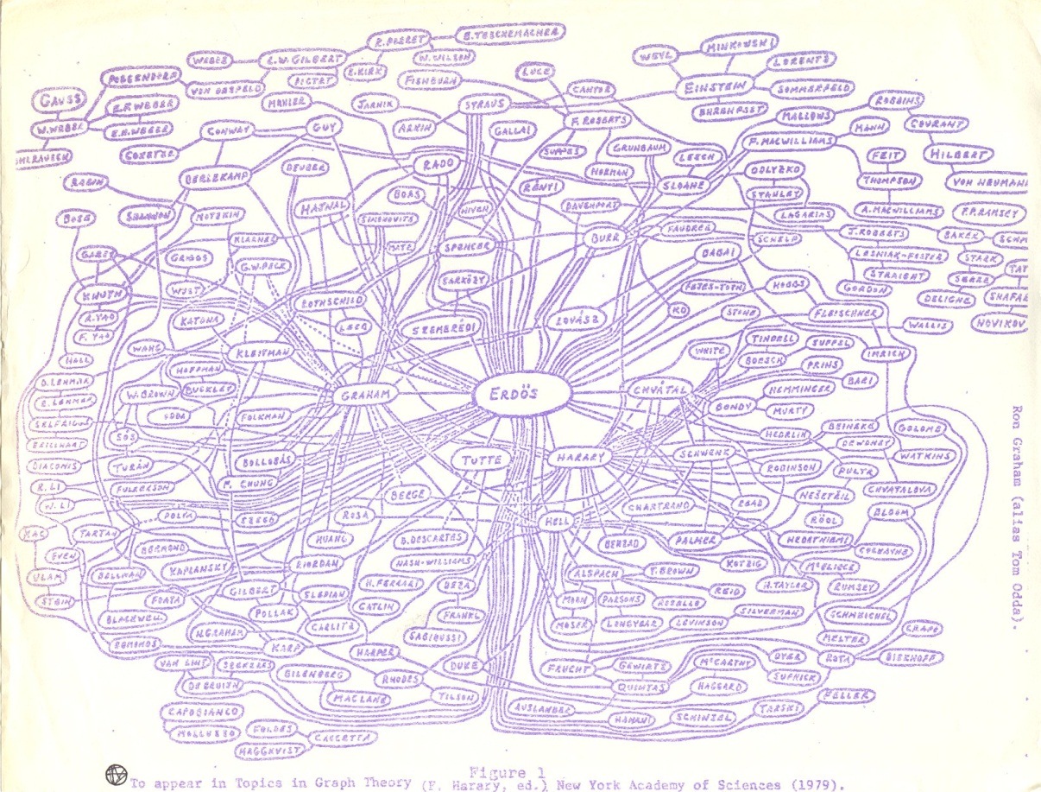
Example 3
Triangles used for assessing Content Quality in Social Networks
The amount of triangles in the self-centered social network of a user is a good indicator of the role of that user in the community!
Welser, Gleave, Fisher, Smith Journal of Social Structure 2007

Slide 39
Counting Exact Number of Triangles
Two simple approaches:
Node Iterator
count the edges among the neighbors of each vertex
Edge Iterator
count the common neighbors of the endpoints of each edge
Not practical for large graphs!!!

Slide 40
A Fast Triangle Counting Algorithm

Slide 41
Main Idea
Instead of treating all the nodes in similar fashion do:
Partition the vertices into “large” and “small” degree
Treat them appropriately

Slide 42
Graph Setup
We have an unweighted and undirected graph G with
n nodes
edges (m >=n)
The nodes are numbered: 1, 2, …. n (integers)

Slide 43
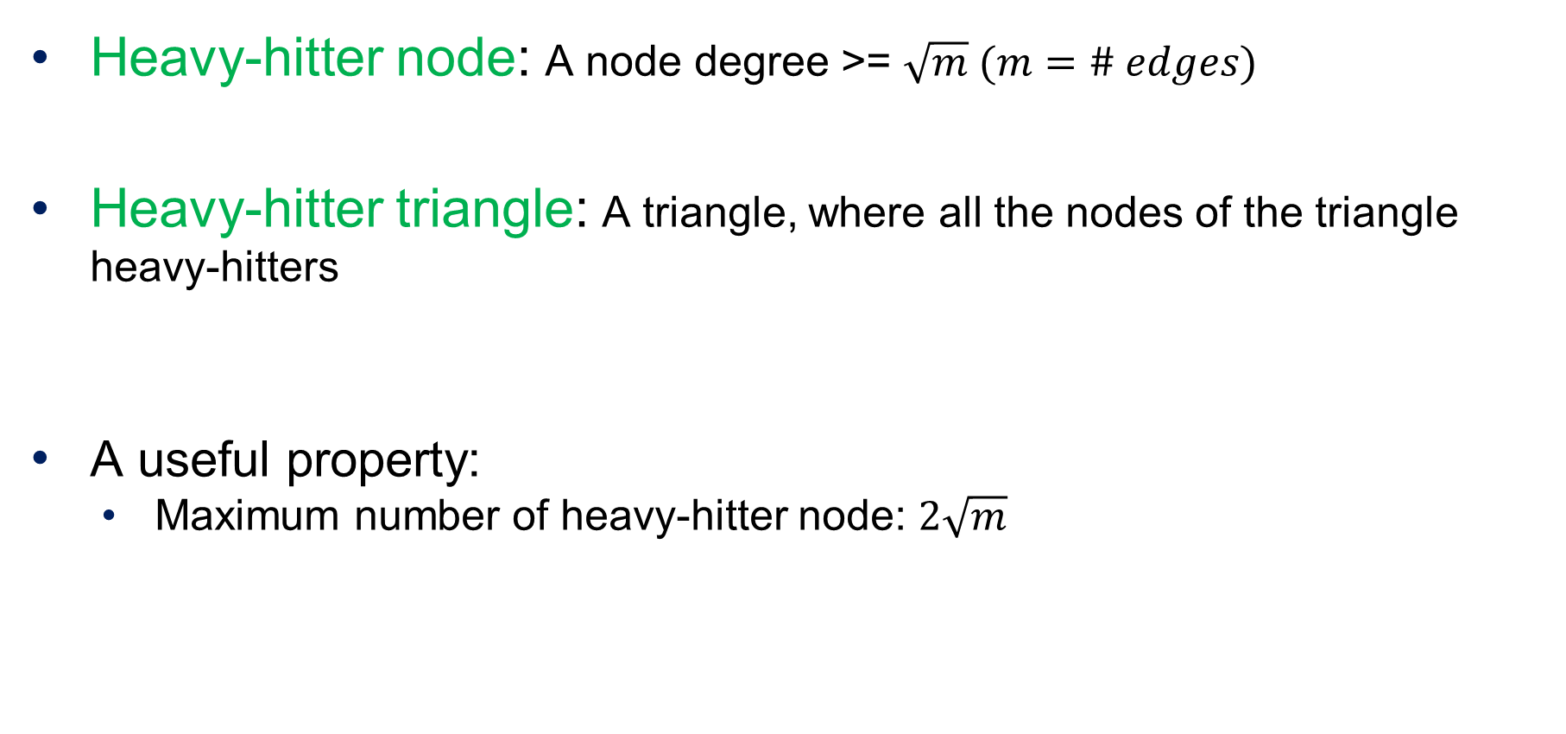
Key concepts based on node degrees
Heavy-hitter node: A node degree >= $\sqrt{m} (m=\# edges)$
Heavy-hitter triangle: A triangle, where all the nodes of the triangle heavy-hitters
A useful property:
Maximum number of heavy-hitter node: $2\sqrt{m}$

Slide 44
The Main Algorithm
Consists of two stages
Preprocessing stage
Goal is to quickly find out the following three things
Heavy-hitter nodes
Existence of an edge between two nodes
List of adjacent nodes
Triangle counting stage
Counting triangles based on heavy-hitter nodes
Counting other triangles

Slide 45
Preprocessing stage
Compute the degree of each node
Objective: To separate heavy-hitters from the non-heavy hitters
Time: O(m)
Create an index (hash table) on edges with pair of nodes of the edge as the key
Objective: To find if an edge between two nodes exists
Time: O(m)
Adjacency list for each node v
Objective: To find set of adjacent nodes of a given node
Time: O(degree(v))

Slide 46
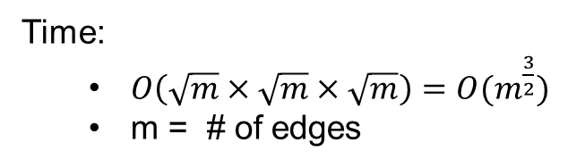
Triangle Counting Stage
Count heavy-hitter triangles:
Take the heavy hitter nodes, H (say)
Consider all sets of three nodes in H
Using the hash table, check if the edge between them exists
Time:
$O\left(\sqrt{m}×\sqrt{m}×\sqrt{m}\right)=O(m^{\frac{3}{2}})$
m = # of edges

Slide 47
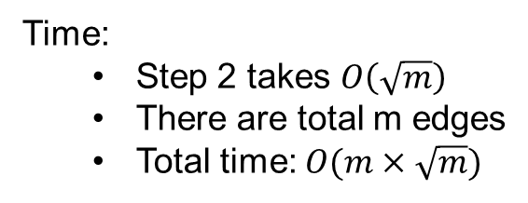
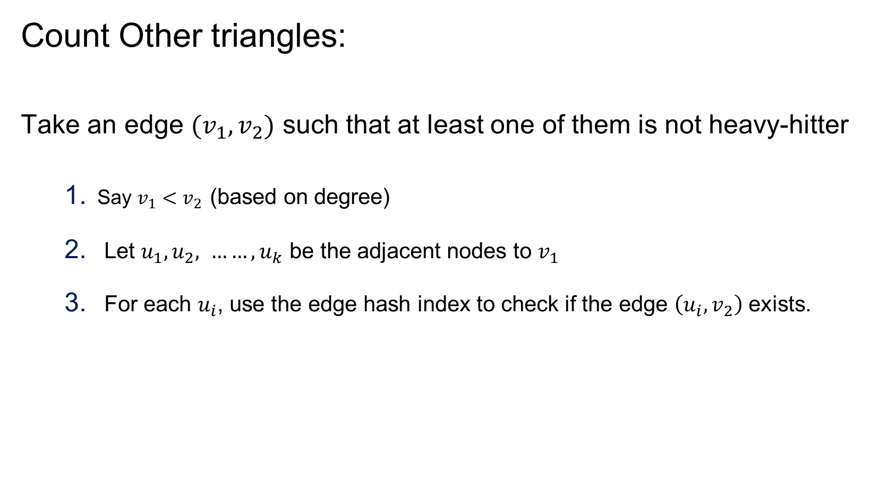
Triangle Counting Stage
Count Other triangles:
Take an edge $(v_{1},v_{2})$ such that at least one of them is not heavy-hitter
Say $v_{1}<v_{2}$ (based on degree)
Let $u_{1}, u_{2}, ……, u_{k}$ be the adjacent nodes to $v_{1}$
For each $u_{i}$, use the edge hash index to check if the edge $\left(u_{i}, v_{2}\right)$ exists.
Time:
Step 2 takes $O\left(\sqrt{m}\right)$
There are total m edges
Total time: $O(m×\sqrt{m})$

Slide 48
Fast Graph Partitioning for Community Discovery

Slide 49
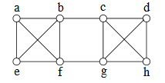
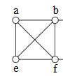
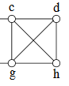
Graph Partitioning: Minimum Cut
Minimum cut of a graph
Partition on nodes in two groups $S_{1} and S_{2}$ so that the # edges between $S_{1} and S_{2}$ are minimized
Example
For the above graph, the min cut partition is {a,b,e,f} and {c,d,g,h}

Slide 50
Graph Partitioning using Min Cut
Use a min cut algorithm to break a graph into two sets
Use the min cut algorithm to further break the smaller graphs

Slide 51
Karger’s Min Cut Algorithm
The algorithm is based on edge contraction
Repeat until just two nodes remain
Pick an edge at random
Collapse its two endpoints into a single node

Slide 52

Karger’s Min Cut Algorithm
It stands on two keys things
Randomized decision (which edge to choose next)
Edge contraction: Collapse its two endpoints into a single node
1
2
1
2,3
3

Slide 53
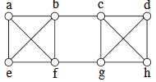
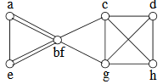
Karger’s Min Cut Algorithm: Example
14 edges to choose from (Pick b –f with prob 1/14)
Source: Sanjeev Arora, Princeton University

Slide 54
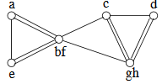
Karger’s Min Cut Algorithm: Example
13 edges to choose from Pick g - h with prob 1/13

Slide 55
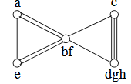
Karger’s Min Cut Algorithm: Example
12 edges to choose from Pick d - gh with prob 2/12

Slide 56
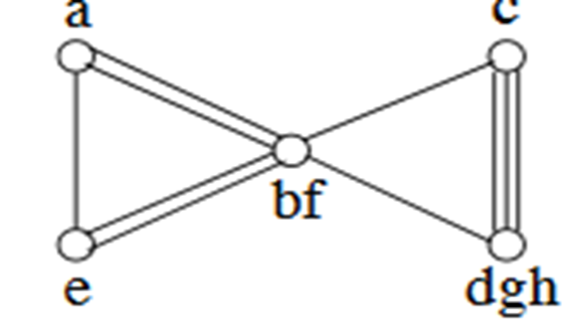
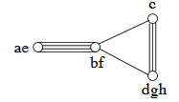
Karger’s Min Cut Algorithm: Example
10 edges to choose from Pick a - e with prob 1/10

Slide 57
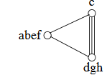
Karger’s Min Cut Algorithm: Example
9 edges to choose from Pick ae – bf with prob 4/9

Slide 58
Karger’s Min Cut Algorithm: Example
5 edges to choose from Pick c - dgh with prob 3/5
Cut value: 2
# of parallel edges in the final two-node graph
DONE: just two nodes

Slide 59
Karger’s Min Cut Algorithm
An Important Note
It is a randomized algorithm
Therefore, for good result do the following
Run Karger’s algorithm multiple times
(it will produce multiple cuts)
Take the cut with the minimum value

